Slide 1

Generative Artificial Intelligence and Optimisation Framework for Sustainable Concrete Mixture Design
Presented by:
Teiboklang Chyne
234156019
Indian Institute of Technology Guwahati
Supervised by :
Dr. Biranchi Panda
Assistant Professor
Indian Institute of Technology Guwahati
Notes:
Introduction section of the article:
Revolution in Construction: The introduction of 3D-concrete printing is revolutionizing the construction industry, offering unique opportunities and challenges1.
Major Challenge: The iterative process of mix design formulation in 3D printing leads to significant material and time consumption.
Machine Learning Techniques: The research employs machine learning (ML) techniques like XGBoost, SVM, DTR, GPR, and ANN to address these challenges.
Dataset Utilization: A dataset with 21 mix constituent features and 4 output properties was used to investigate the relationship between mix design and performance2.
Evaluation Metrics: Models were assessed using metrics like Mean Absolute Error (MAE), Root Mean Squared Error (RMSE), Mean Squared Error (MSE), and R-squared value.
GPR Performance: Gaussian Process Regression (GPR) yielded the best results, achieving high R-squared values and low RMSE values for both cast and printed strengths.
Model Validation: The ML models were validated using four unique mix designs, which were 3D printed and tested for compressive strength and slump flow34.
Average Error: GPR had an average error of 10.55%, while SVM achieved a slightly lower average error of 9.38%.
Novel Approach: This research presents a novel approach for optimizing 3D-printed concrete by predicting slump flow and compressive strength directly from the mix design5.
Impact on Construction: The approach can facilitate the design and fabrication of 3D-printed concrete structures that meet necessary strength and printability requirements6.

Slide 2

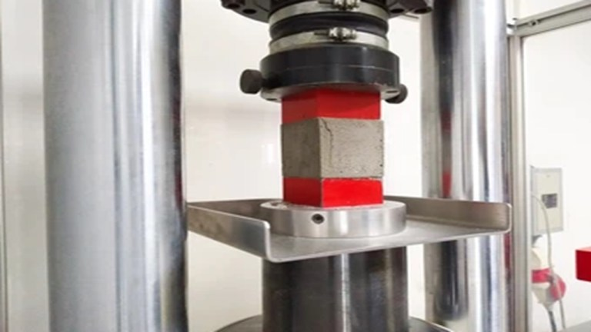

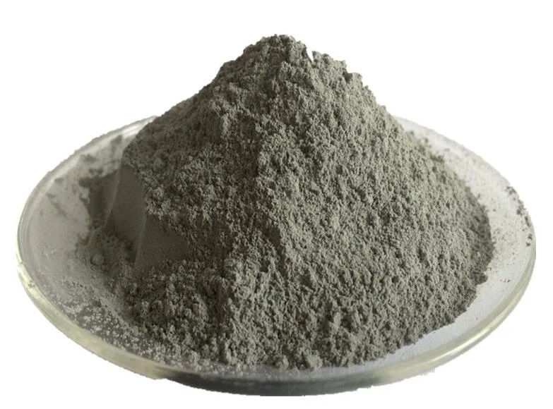
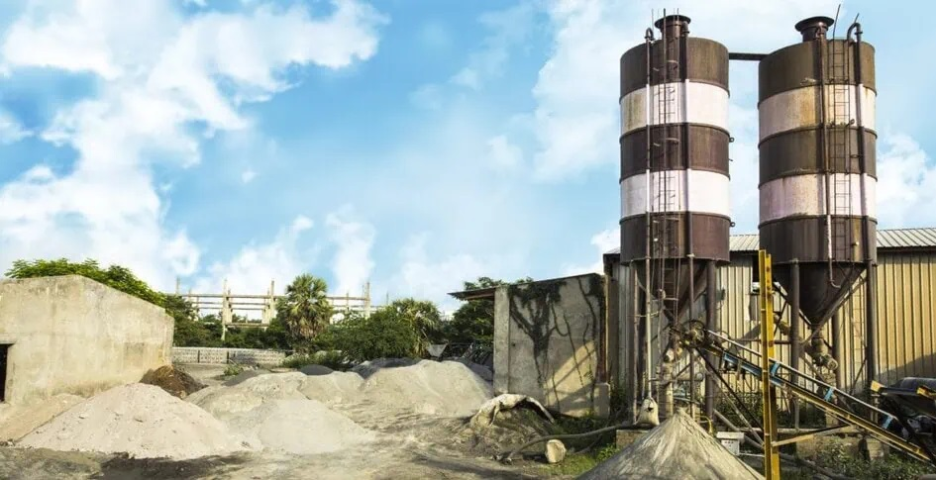
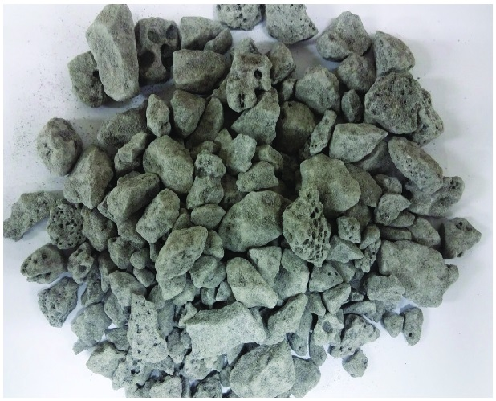
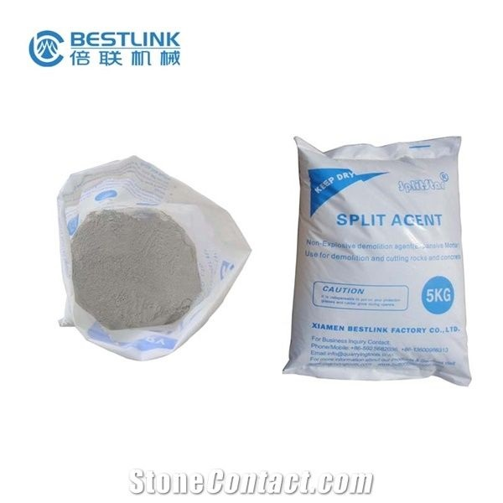
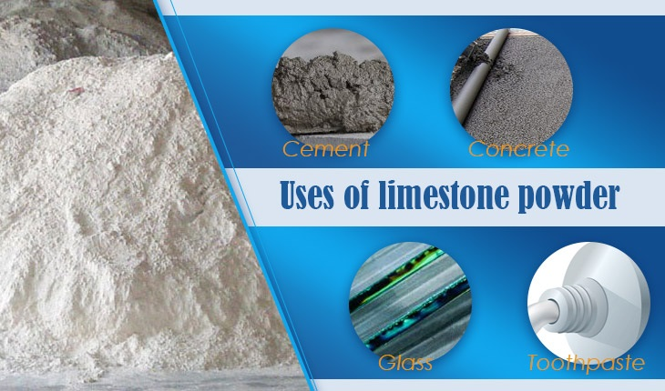
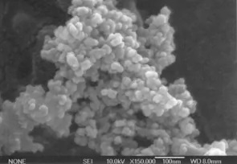
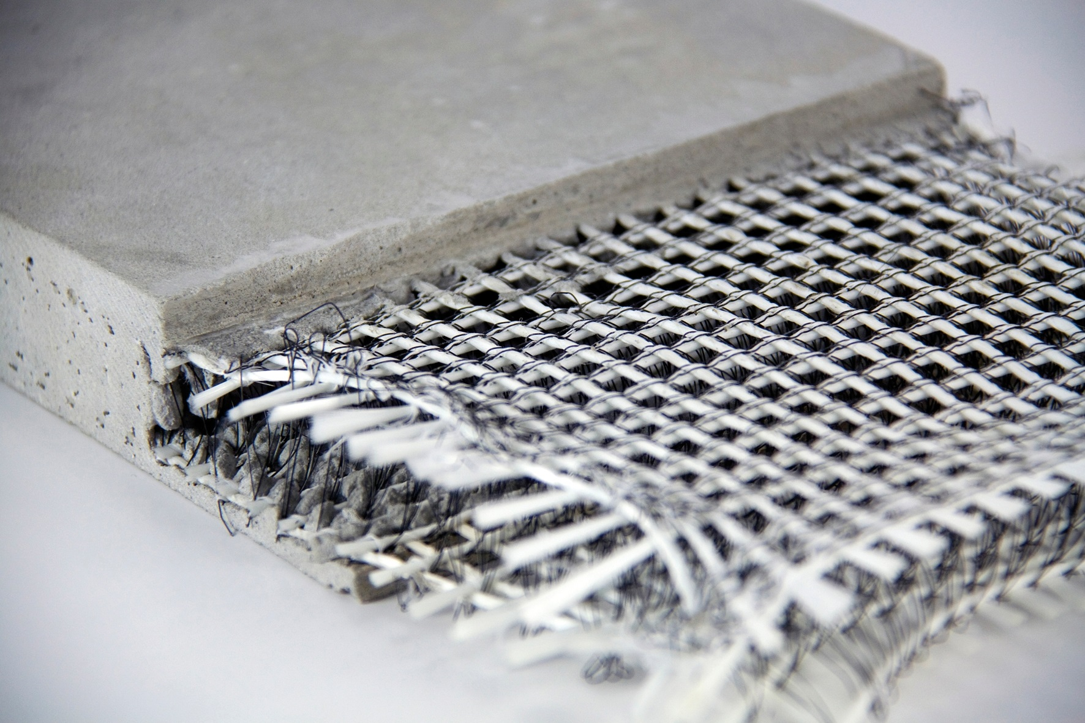



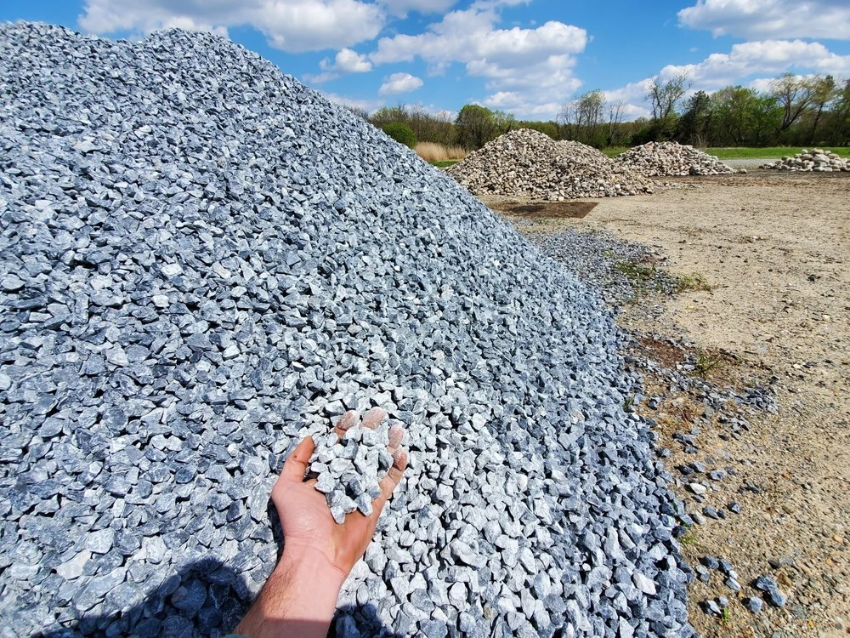

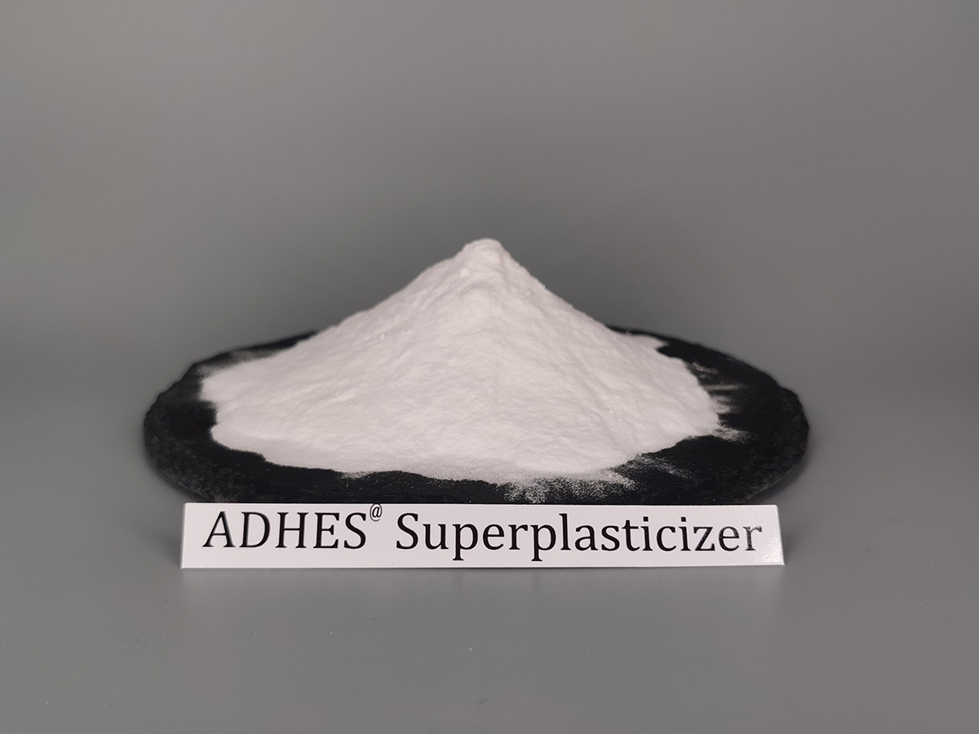



Introduction
Concrete Mix Design
Concrete Parameters
Raw Materials
Cement
Silica Fume
Fly Ash
BFS
Compressive Strength
Quarry
Limestone
Nano-Silica
Fiber
Sand
Gravel
Water
Superpl’zer
Cost
Curing Conditions
f
Temperature
Humidity
Embedded Carbon
Notes:
Concrete is an important material in the construction industry. All modern construction use concrete.
The goal of mix design in concrete is to determine raw materials and the curing conditions to achieve certain properties according to the intended application.

Slide 3
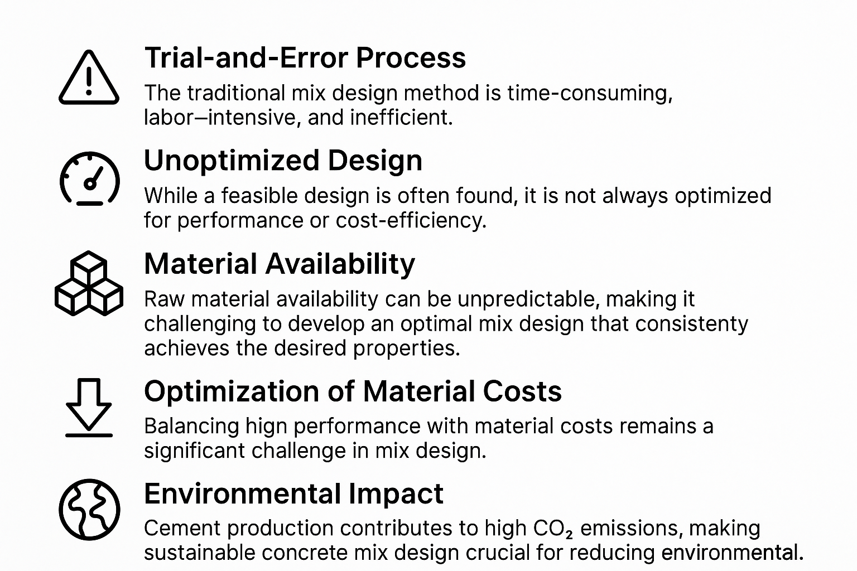
Challenges in Concrete Mix Design

Slide 4
Literature Review: Regression and Optimization
Author(s) | Objective | Method(s) | Key Contributions
Van Tran et al. (2024) | Predict workability of 3D printable concrete with steel slag aggregate | Bayesian Regularization and Evolution Algorithm | Proposed a hybrid ML framework for robust workability prediction; achieved improved generalization and reliability for concrete with alternative aggregates.
Huang et al. (2022) | Predict compressive strength of ternary concrete containing cement, fly ash, and slag | Firefly Algorithm (FA) + Random Forest (RF) | Proposed a hybrid FA-RF model for accurate strength prediction; demonstrated superior performance compared to standalone ML methods.
Katlav et al. (2024) | Forecast compressive strength of ultra-high-performance concrete (UHPC) | CatBoost model optimized with various algorithms | Enhanced UHPC strength prediction using optimized CatBoost; demonstrated improved accuracy over traditional ML approaches through comparative optimization techniques
Mohammadi Golafshani et al. (2024) | Predict and optimize compressive strength of recycled aggregate concrete for sustainable mix design | Multiple ML models + Stacking + Multi-objective Water Cycle Algorithm | Achieved high prediction accuracy using stacking; identified key factors via sensitivity analysis; optimized mix for strength, CO2 emissions, and cost using water cycle algorithm; developed user-friendly interface.
Zheng et al. (2023) | Perform multi-objective optimization of concrete mix design using ML | Bayesian Optimization, 12 Machine Learning models + NSGA-III and C-TAEA | Developed an ML-based framework for optimizing concrete mixes; balanced compressive strength with other mix performance objectives; demonstrated effectiveness in practical mix design scenarios.
Notes:
In the literature, researchers have applied machine learning methods to optimize the mix design process. Some papers reviewed include …
NSGA-III: Non-dominated Sorting Genetic Algorithm III
C-TAEA: Cumulative Topological Adaptive Evolutionary Algorithm

Slide 5
Literature Review: Generation
Author(s) | Objective | Method(s) | Key Contributions
Chiu et al. (2023) | Design composite structures with bioinspiration using generative models | CVAE + Genetic Algorithm | Combined CVAE with GA to optimize bioinspired structures; improved material efficiency and performance.
Rivera-Perez et al. (2024) | Optimize asphalt mix design using deep learning | Autoencoder + DNN | Used unsupervised autoencoders to guide asphalt concrete design; reduced trial-and-error in lab testing.
Yu et al. (2023) | Use generative AI for engineered cementitious composite design | ANN, Invertible Neural Network | Applied generative modeling to ECC design; improved mechanical performance and design flexibility.
Le Nguyen et al. (2024) | Optimize concrete mixtures for cost and carbon using generative AI | BO + ML models, Generative AI + MOO | Developed framework for low-cost, low-carbon mix design; enabled automated generation of optimal concrete formulations.
Gao et al. (2024) | Generate sustainable concrete mixes using AI | Variational Autoencoder | Demonstrated generative model use in concrete mix design; balanced sustainability and structural performance.
Notes:
BO Bayesian Optimization
MOO Multi-Objetive Optimization

Slide 6
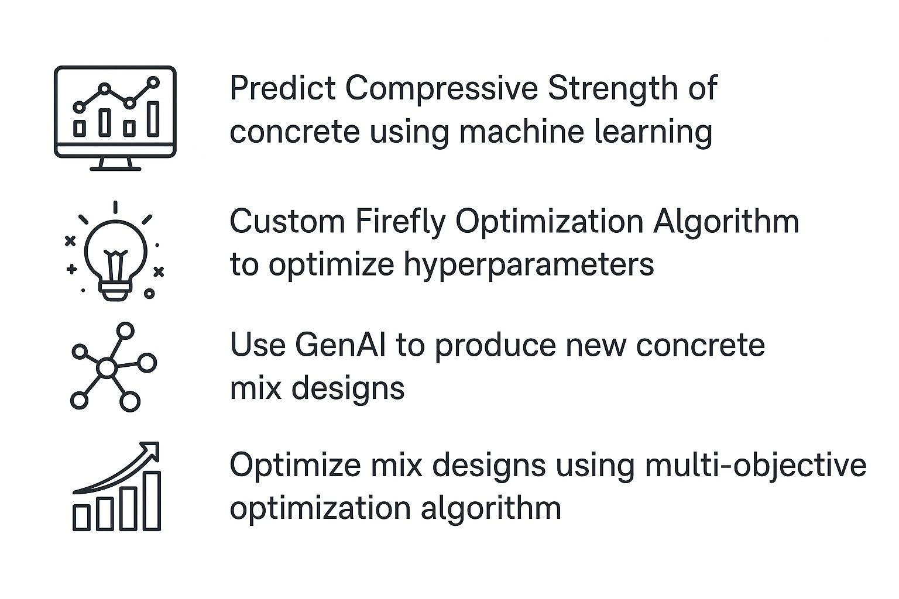
Objectives
Notes:
Literature Gap:
1. Although methods of using ML to improve mix design process exist, however, improvements in various aspects such as accuracy in prediction and variety in mix design generation can be achieved.
2. FA in combination with CatBoost for predicting compressive strength has not been found in the literature.
3. This dataset has also not been used for mix design generation.
4. CVAE has not been used to generate mix design of concrete .
Motivation:
1. Create a framework that will combine prediction, generation, and optimisation in one to help in generating mix design.
2. Add a new leaf in current knowledge of regression and generation pertaining to concrete.

Slide 7
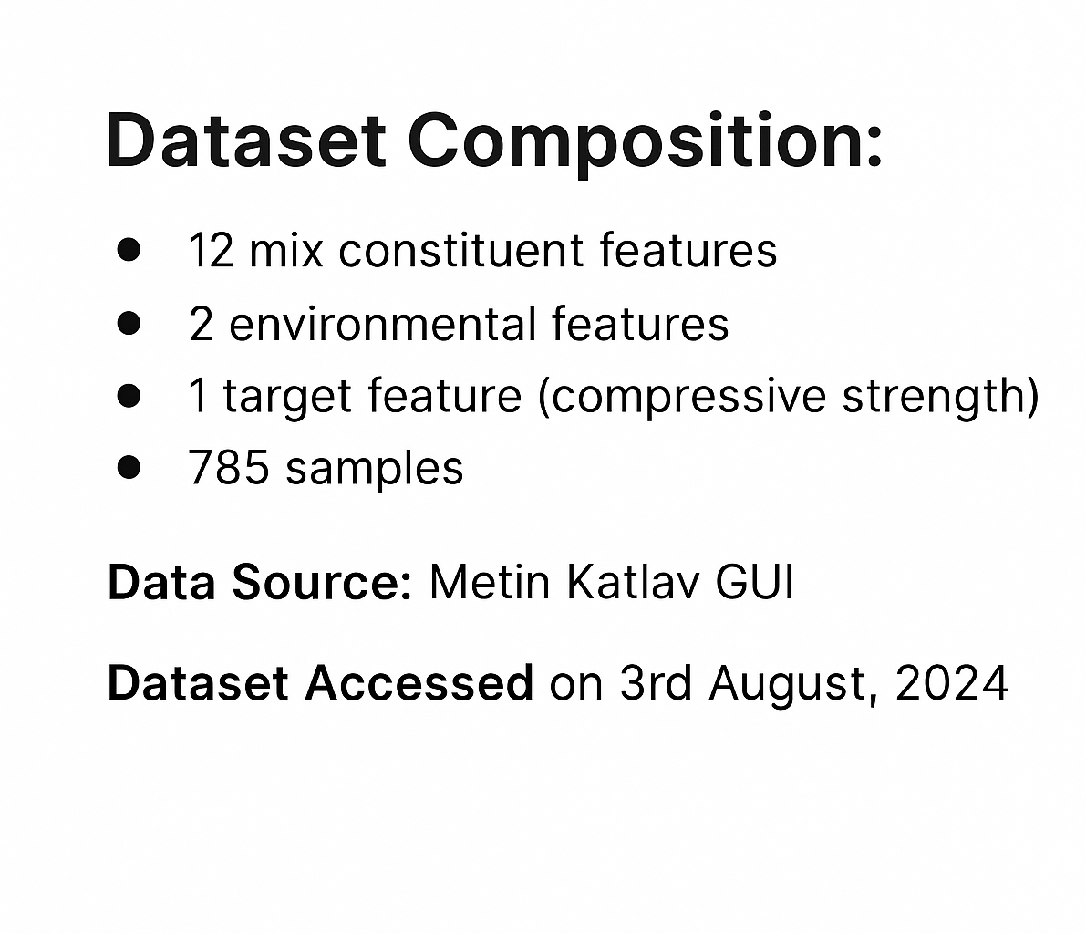

Dataset Description
https://sites.google.com/site/metinkatlav44/graphical-user-interface
Notes:
We will divide the methodology into two parts. Regression and Generation. However, the dataset used is common…

Slide 8
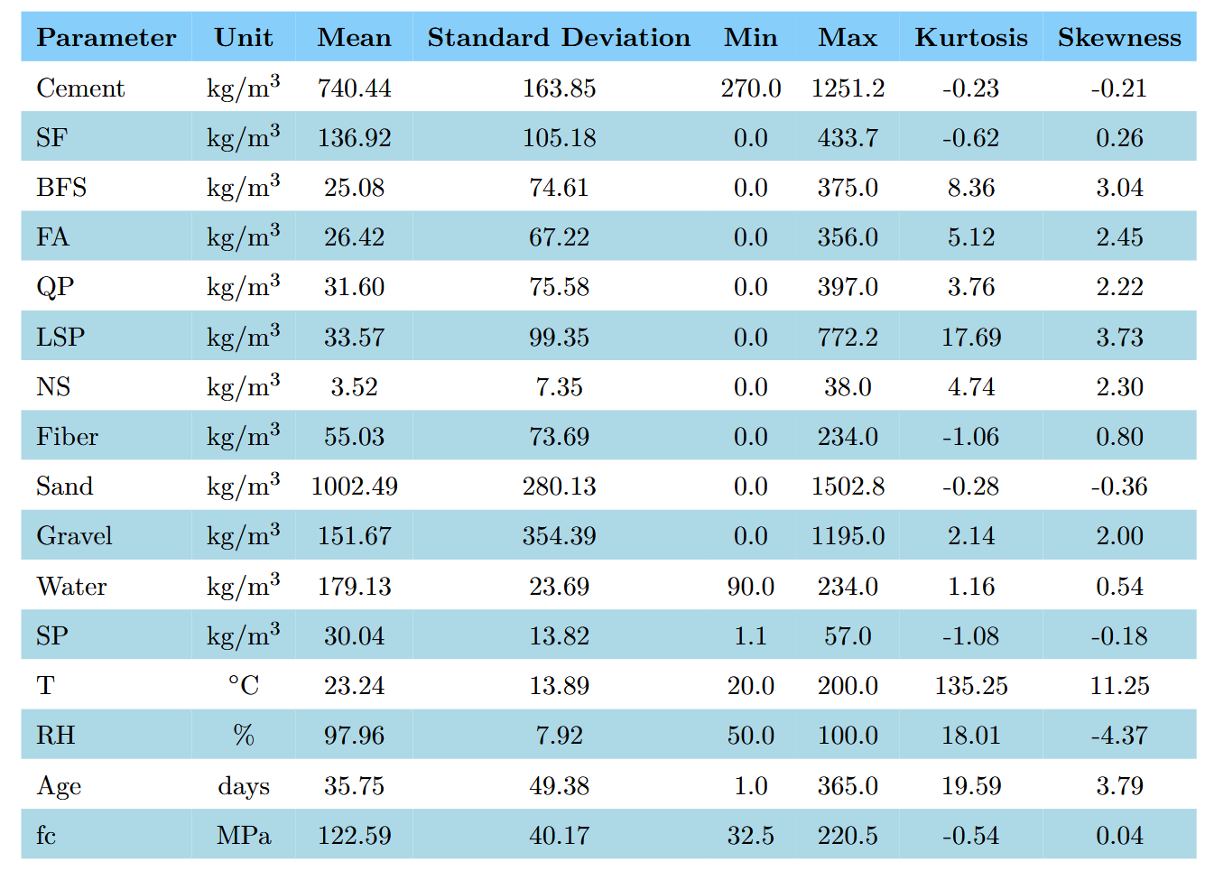
Statistical Description of Variables
Notes:
First, a statistical description of the variables to understand the spread of the features, their range and shape. This is important to decide what algorithm would be suitable for the dataset.

Slide 9
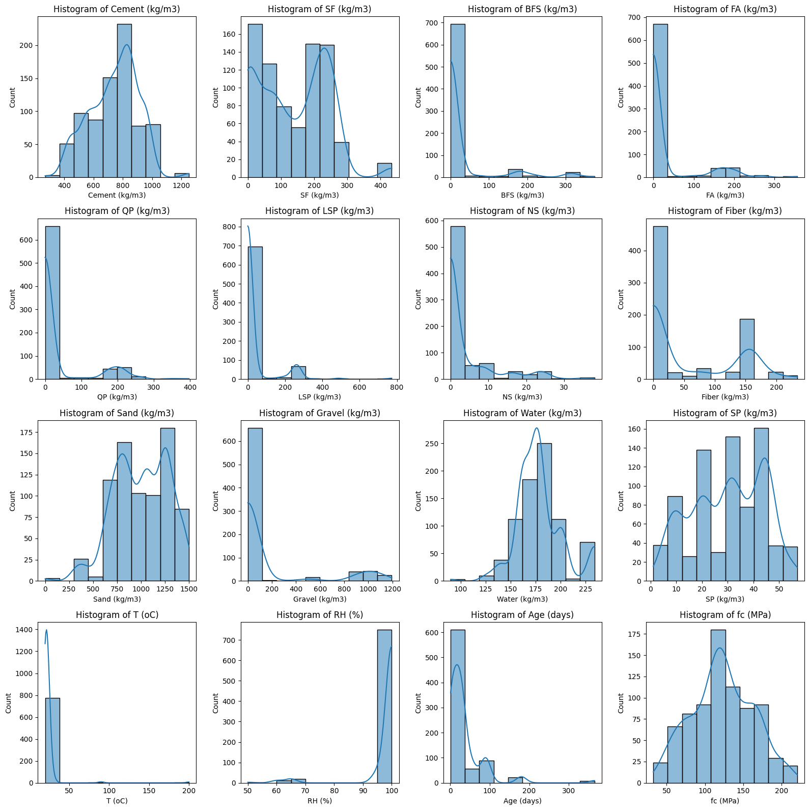
Frequency Distribution of Variables
Notes:
Next is a visual representation of each variable using a histogram to observe the distribution and outlier. As can be seen that the distribution of each varible is different from another. Some are unimodal, some bimodal, some features are positive skewed some negative skewed. We can also see that half of the components are not used at all in most of the mixture as seen by the high frequency at 0 values.
Skewed and sparse distributions (e.g., BFS, QP) can reduce feature importance and may require
transformation or binning.
Features with bimodal or multimodal distributions (e.g., Fiber, Age) might suggest latent
categories and could benefit from conditional modeling (e.g., CVAE).
Uniform or normal-like distributions (e.g., fc, Cement) help in training stable models without
special preprocessing.

Slide 10
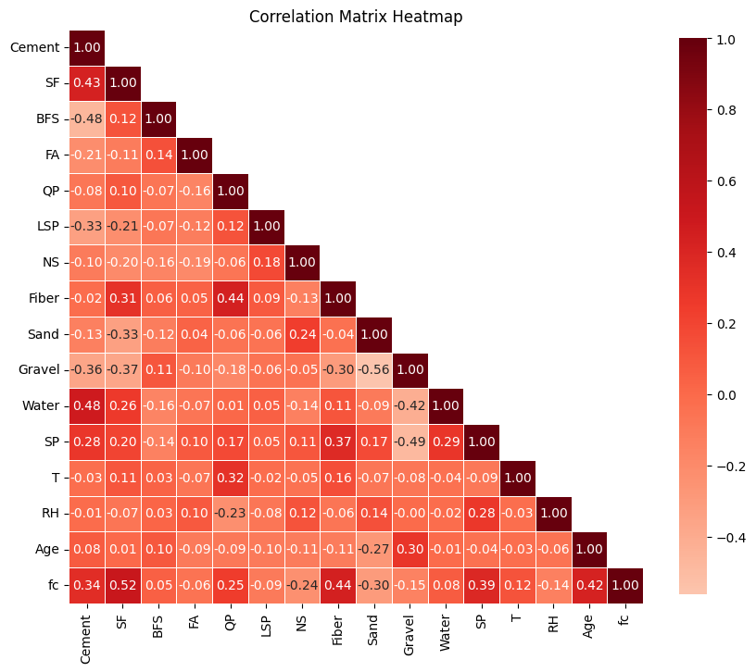
Correlation Matrix Heatmap of Variables
Notes:
Next is the correlation heatmap. As seen here, all variables have less than 0.5 correlation with each other. This shows that the linear relation between variables is weak. This also rules out simple methods like linear regression.

Slide 11
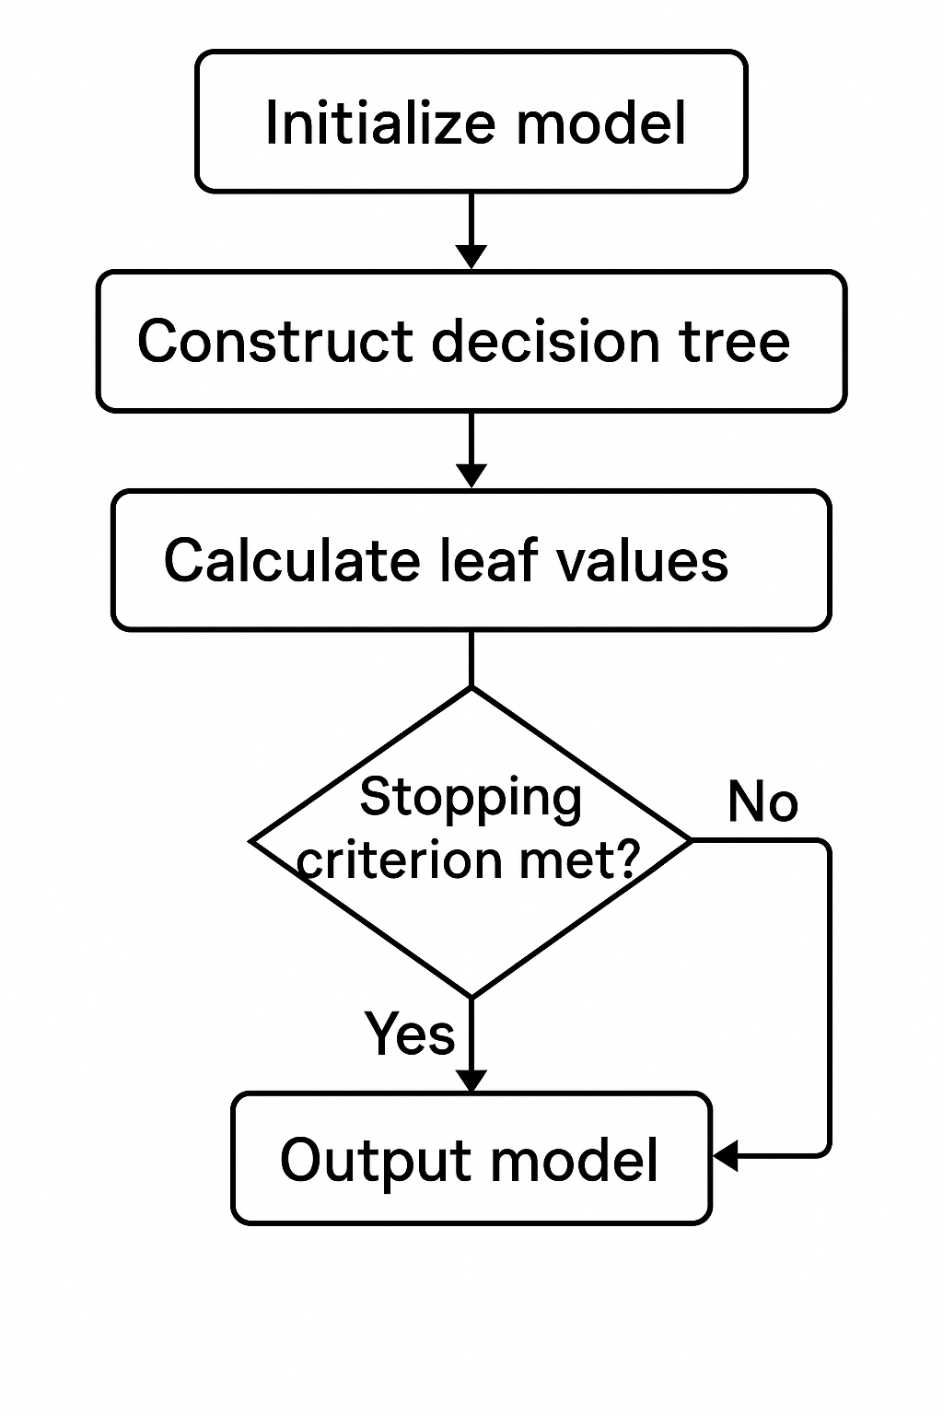

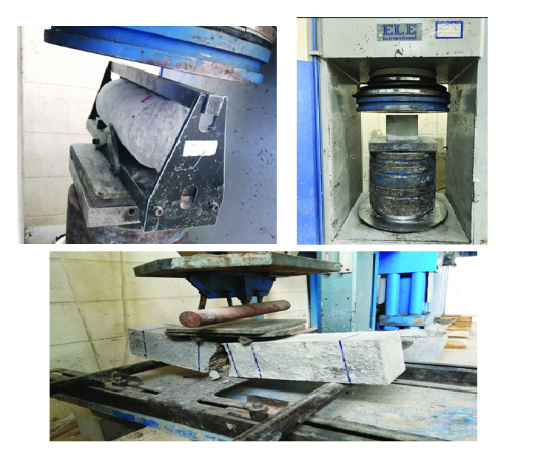
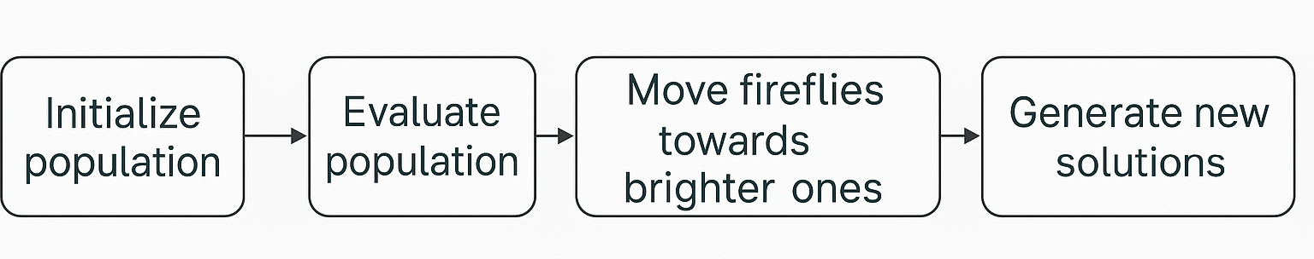
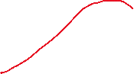
Methodology – Regression
Dataset Generation
Inputs
CatBoost
Prediction
Experiments
Compressive Strength
Compressive Strength
Time
Firefly Algorithm
Notes:
Based on the data description, given the distribution of the variables and lack of linear correlation, a model catboost was chosen for regression… Look at the graph and explain step by step.

Slide 12
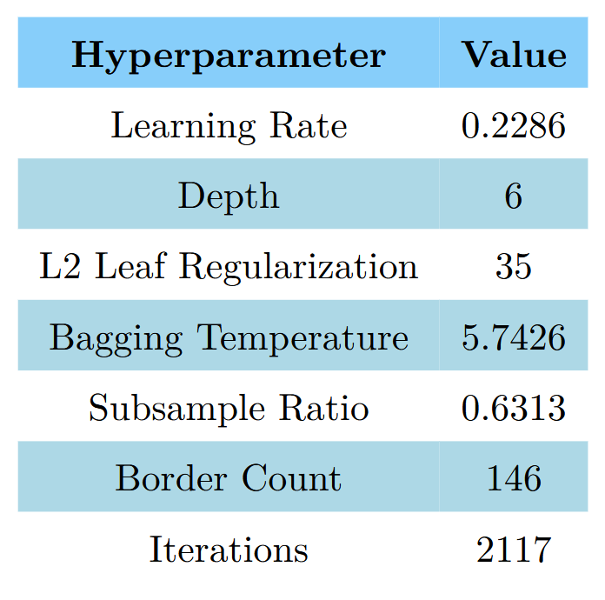
Optimized CatBoost Hyperparameters

Slide 13
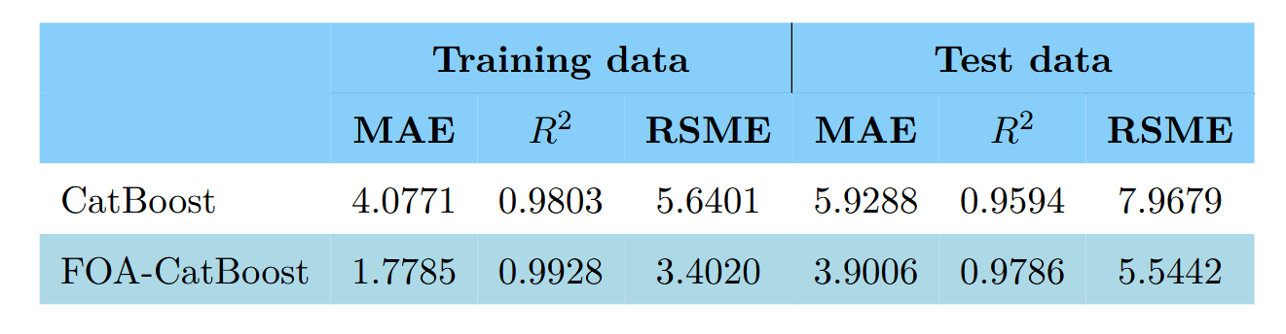
Results Comparison
Notes:
CatBoost shows a noticeable drop from train to test (0.9803 to 0.9594), and increased test
RMSE.
FOA-CatBoost maintains a narrow gap between train and test performance (Train : 0.9928, Test
: 0.9786), with lower errors across both.
This indicates reduced variance and better bias-variance trade-off after tuning
In the testing set regression, FOA-CatBoost achieved an MAE of 3.9006, indicating a 34.20% improvement over the default model.
The R2-score rose to 0.9786, an enhancement of 2%, demonstrating that the model could explain nearly 97.86% of the variance in compressive
strength.
Furthermore, the model achieved an RSME score of 5.5442 which is an improvement of 30.42% over the default model.

Slide 14
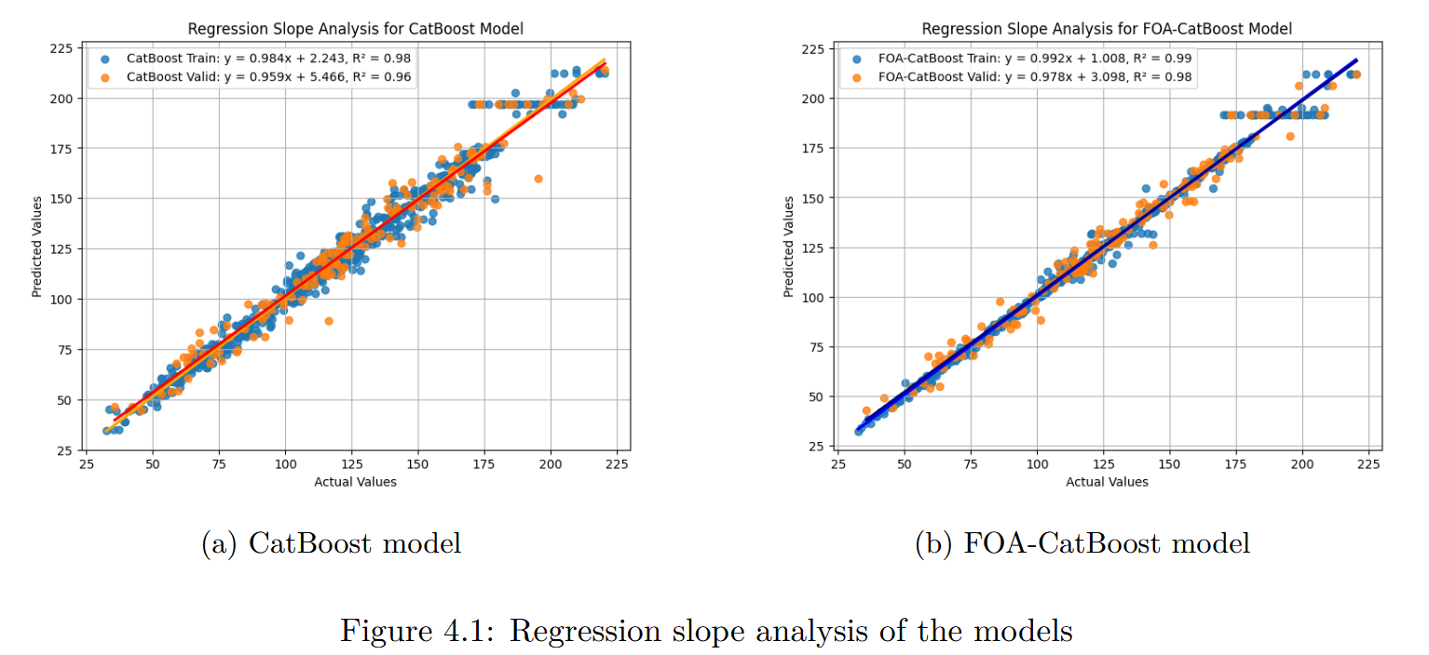

Regression Slope Analysis

Slide 15
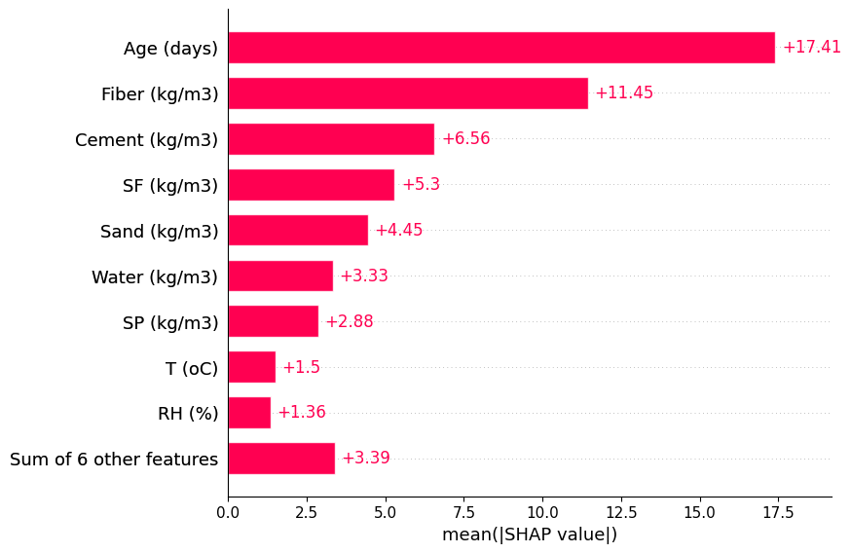
Mean Absolute SHAP values

Slide 16
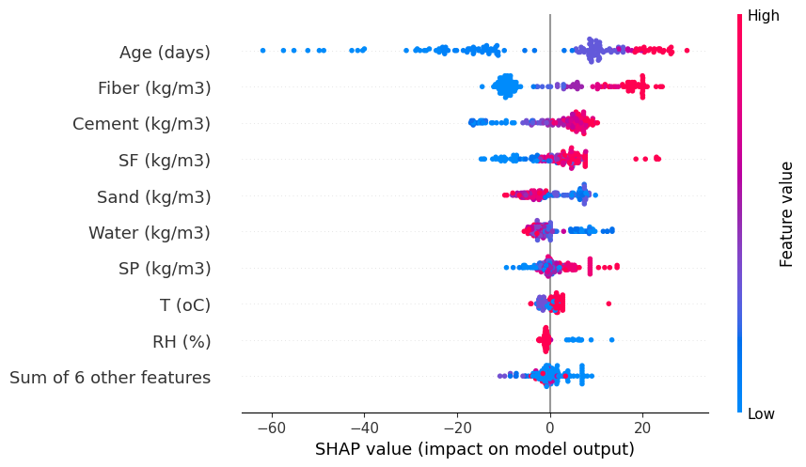
SHAP feature impact

Slide 17
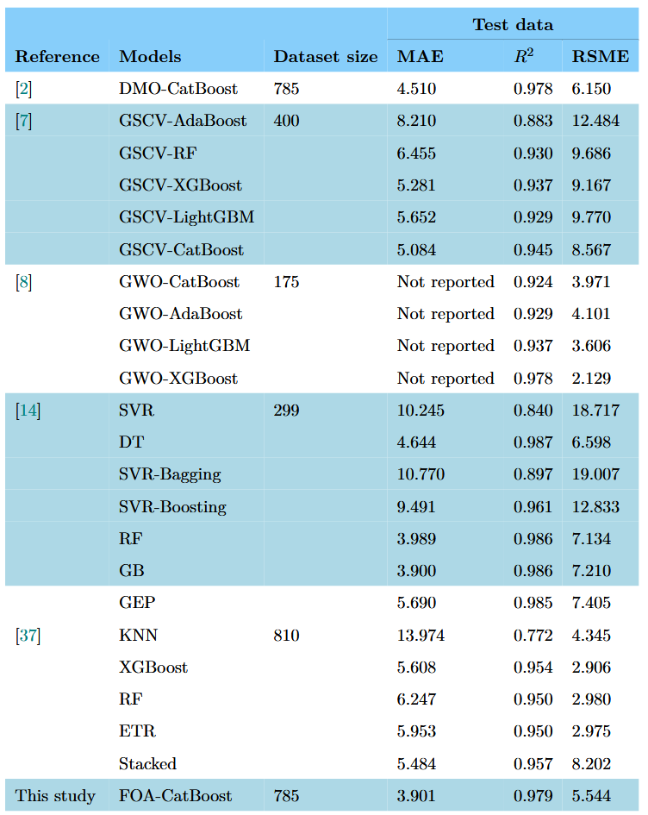
Results Comparison

Slide 18
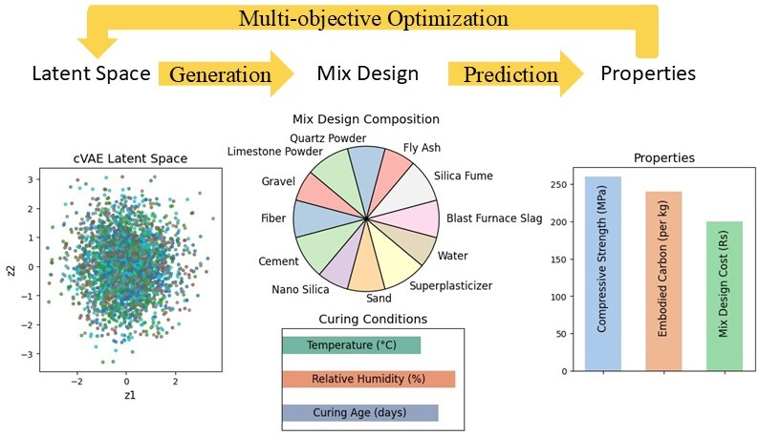
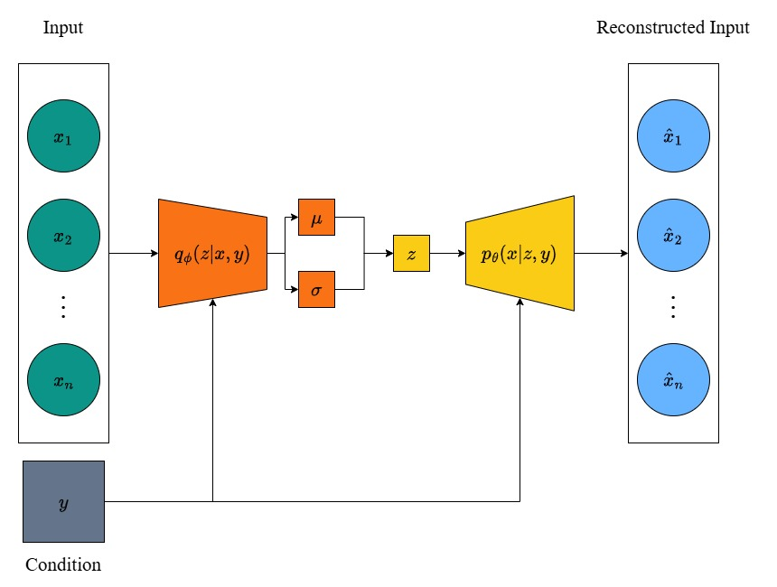
Methodology – Generation
Train CVAE
Mix Design Optimization
Notes:
For the generation of new mix designs, CVAE was chosen. The NSGA-II method was chosen for optimization of mix designs with the goals being …

Slide 19
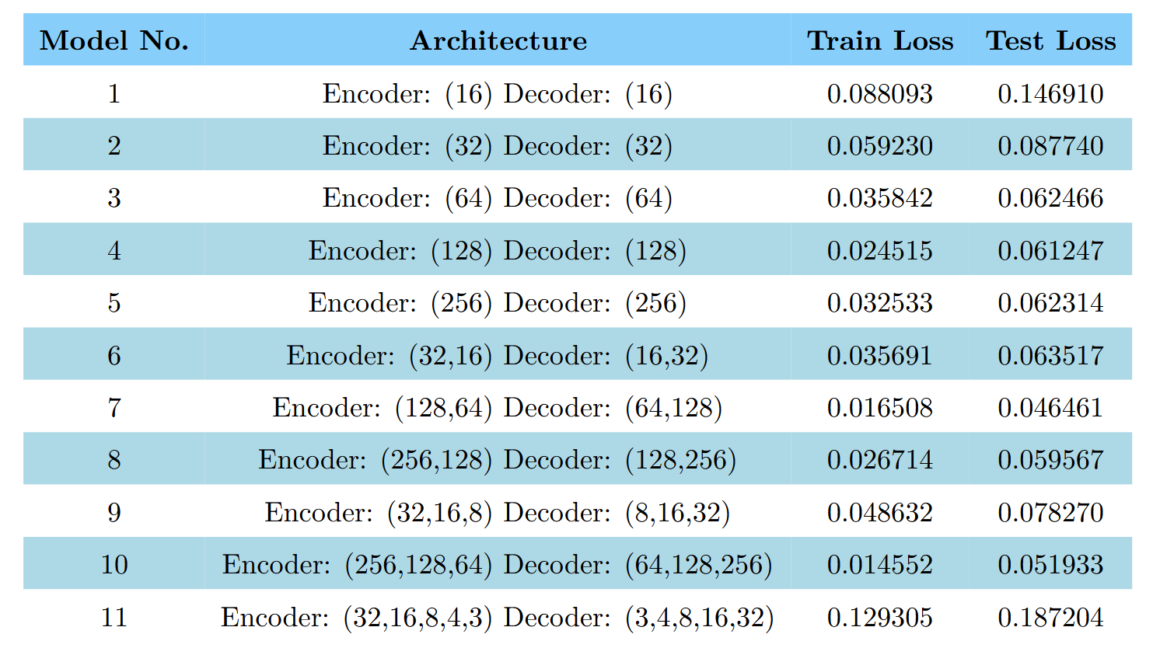
CVAE Architectures Comparison on Losses
Notes:
Various architectures of CVAE were explored and their performance is compared here. The model no 7 was chosen.

Slide 20
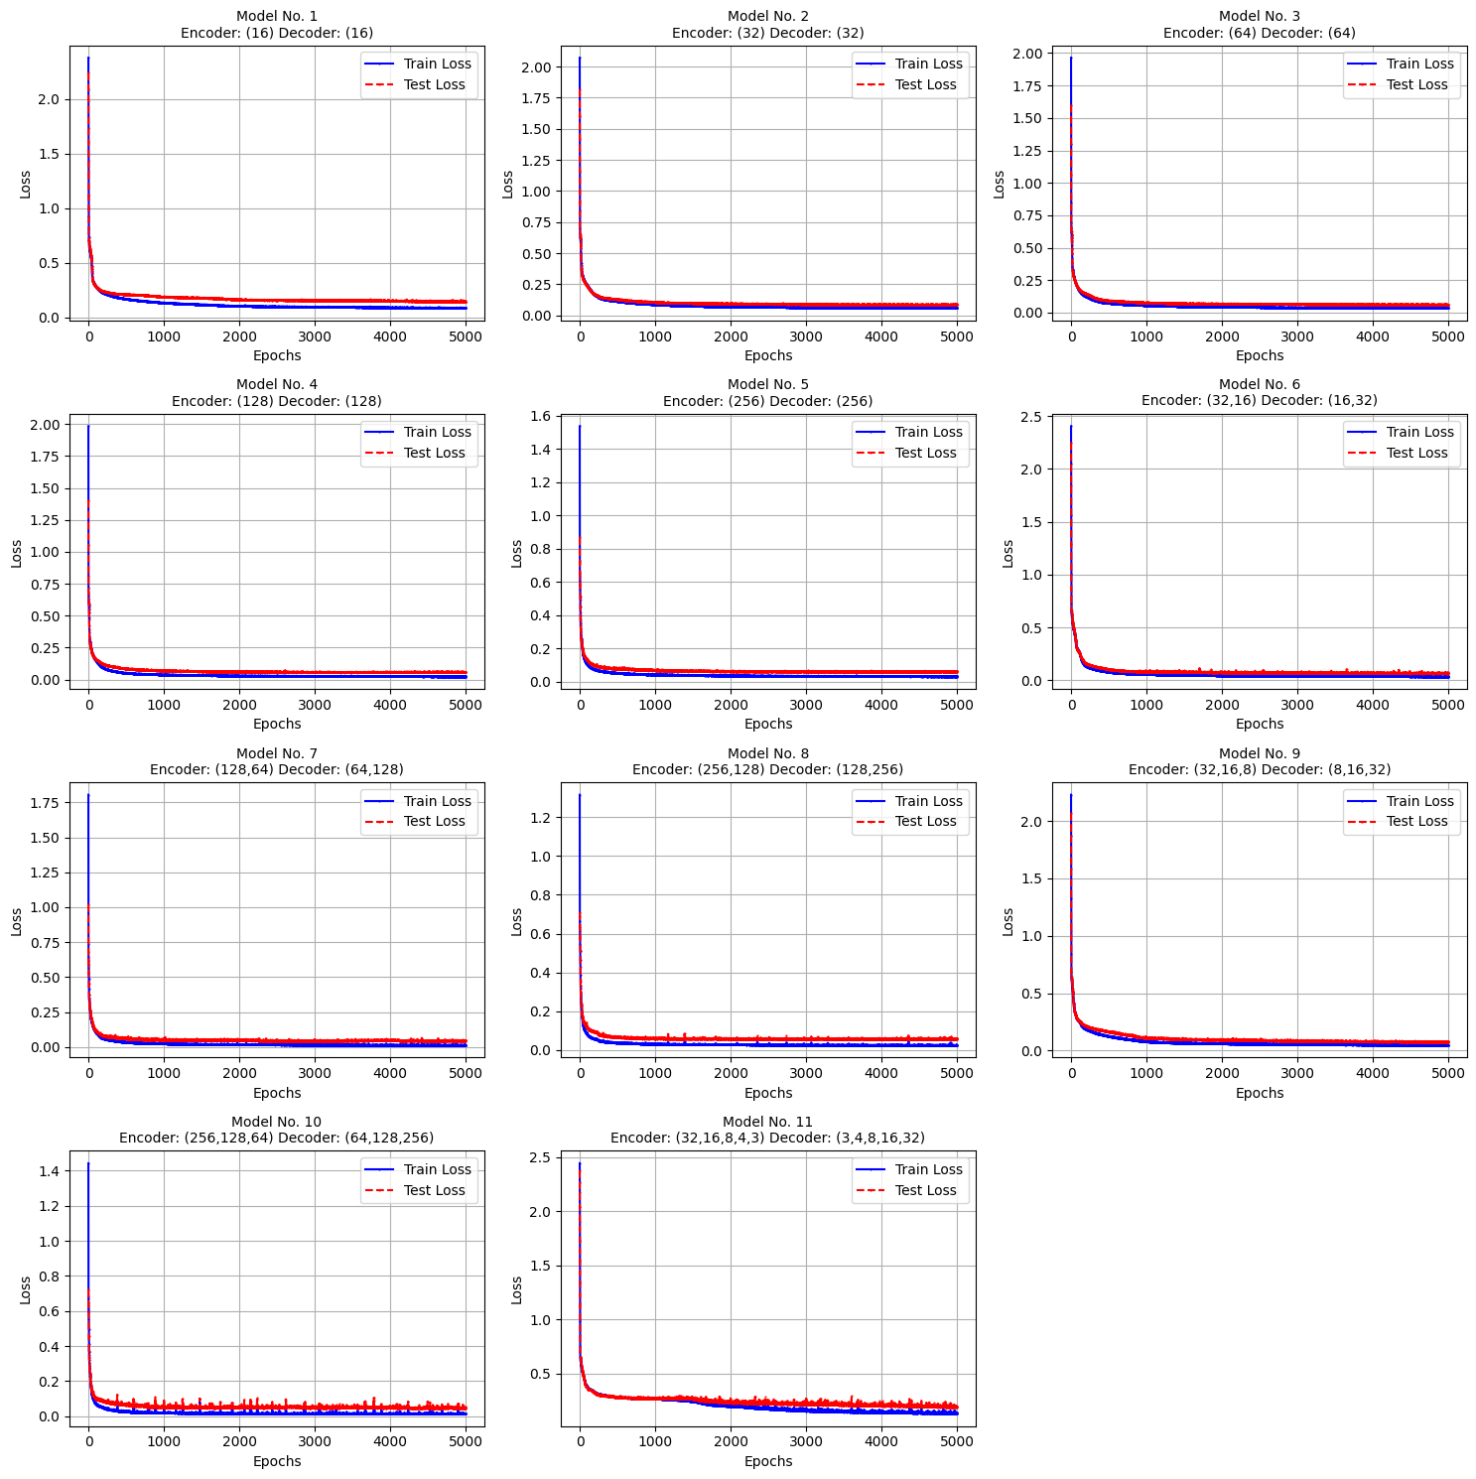
CVAE Architectures Comparison on Learning Curve

Slide 21
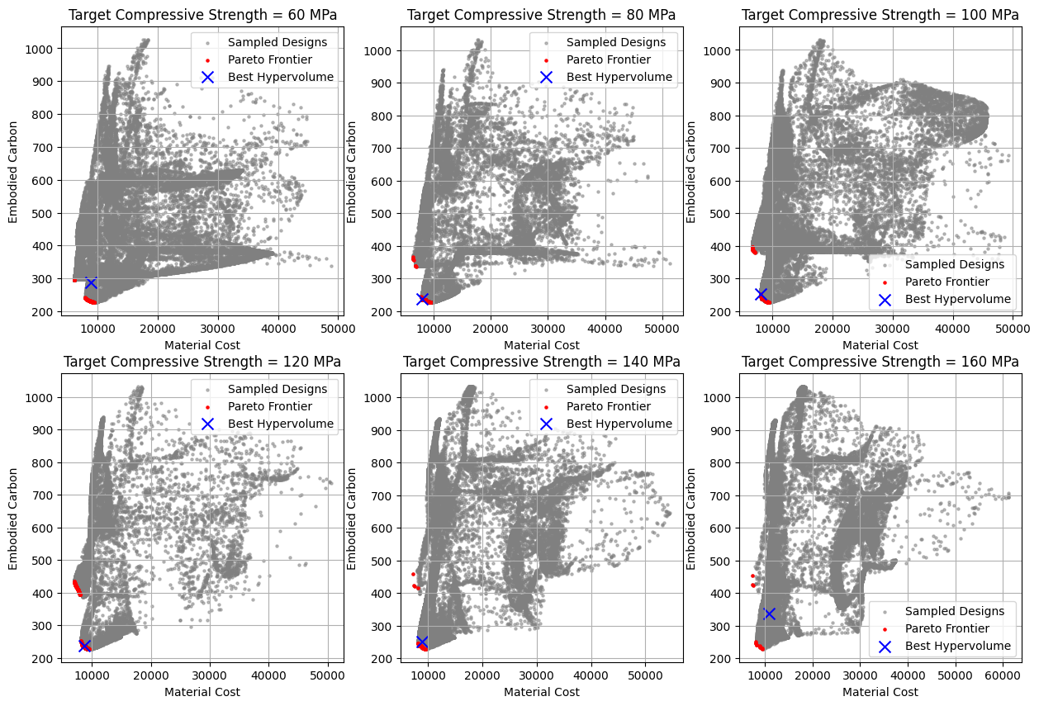
NSGA-II Optimization of CVAE-generated Designs
Notes:
Pareto optimal solutions were chosen on the basis of hypervolume.
Alternatives include Random Search, Grid Search, NSGA-III, SPEA2, Multi-objective PSO

Slide 22
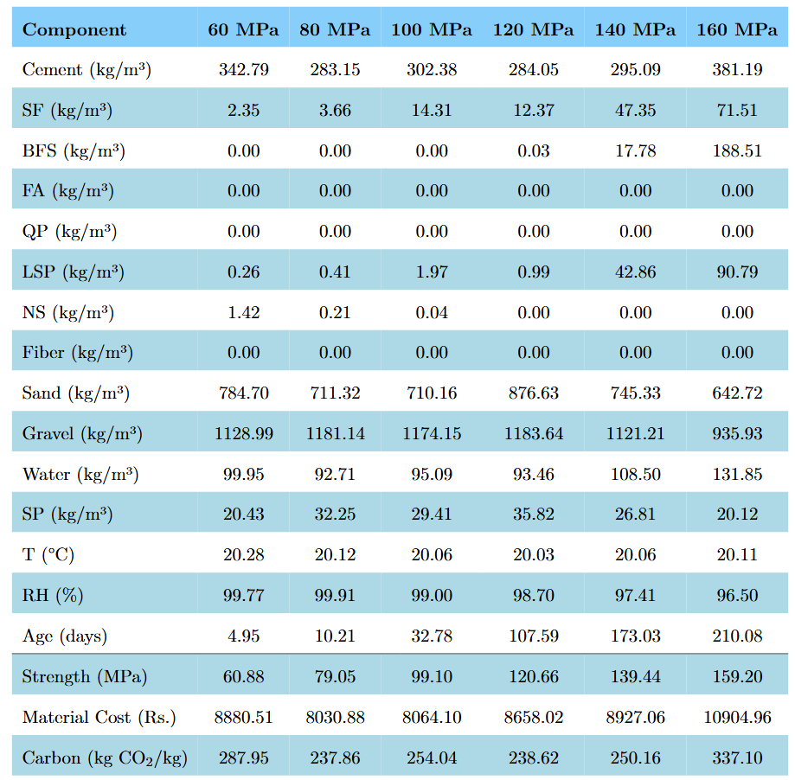
Generated Mix Designs
Notes:
These are some mix designs generated by the model. For 6 different compressive strengths.

Slide 23
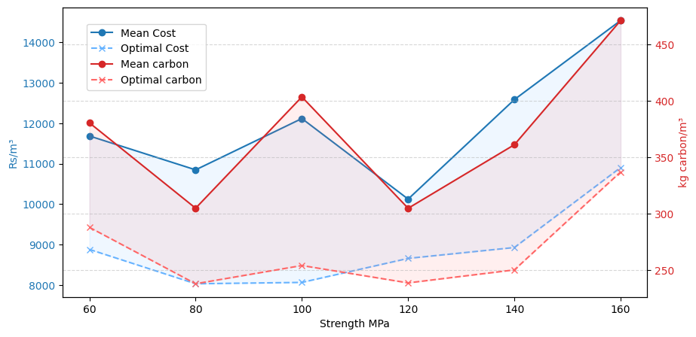
Designs Carbon and Cost Comparison

Slide 24
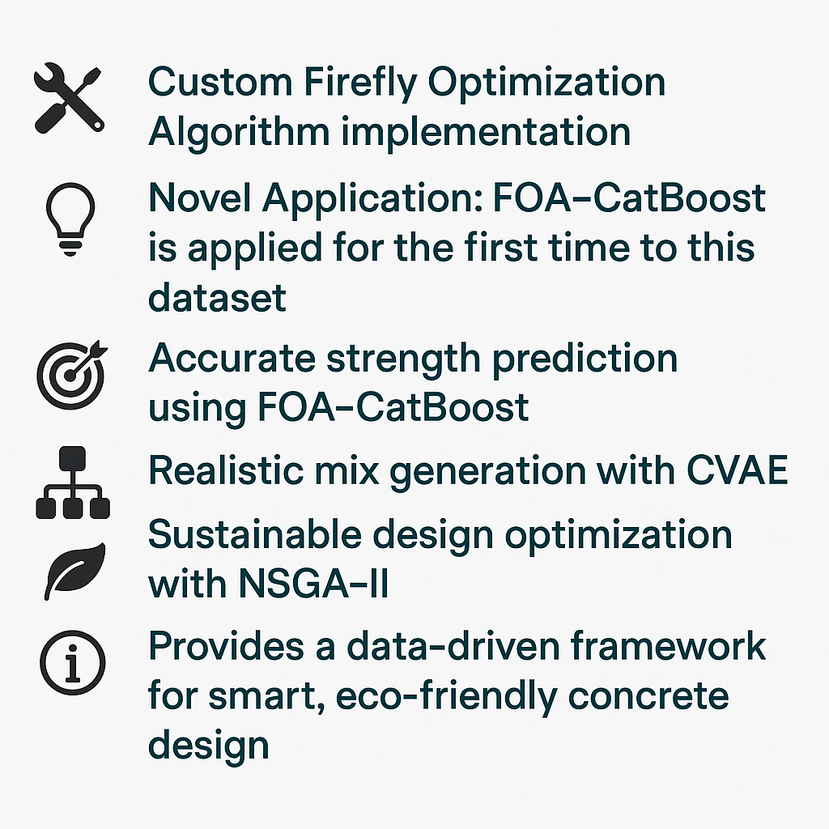
Contributions and Impact
Notes:
FOA is used first time with this dataset. Benchmarked against available literature

Slide 25
References
[1] Metin Katlav and Faruk Ergen. “Improved forecasting of the compressive strength of ultra-high-performance concrete (UHPC) via the CatBoost model optimized with different algorithms”. In: Structural Concrete (2024).
[2] Jianhao Gao, Chaofeng Wang, and SH Chu. “Mix design of sustainable concrete using generative models”. In: Journal of Building Engineering 96 (2024), p. 110618.
[3] Emadaldin Mohammadi Golafshani et al. “A framework for low-carbon mix design of recycled aggregate concrete with supplementary cementitious materials using machine learning and optimization algorithms”. In: Structures. Vol. 61. Elsevier. 2024, p. 106143.
[4] Wu Zheng et al. “Multi-objective optimization of concrete mix design based on machine learning”. In: Journal of Building Engineering 76 (2023), p. 107396.
[5] Jiandong Huang et al. “Predicting the compressive strength of the cement-fly ash–slag ternary concrete using the firefly algorithm (fa) and random forest (rf) hybrid machine-learning method”. In: Materials 15.12 (2022), p. 4193.

Slide 26
References
[6] Mien Van Tran et al. “Robust prediction of workability properties for 3D printing with steel slag aggregate using bayesian regularization and evolution algorithm”. In: Construction and Building Materials 431 (2024), p. 136470.
[7] Yi-Hung Chiu, Ya-Hsuan Liao, and Jia-Yang Juang. “Designing bioinspired composite structures via genetic algorithm and conditional variational autoencoder”. In: Polymers 15.2 (2023), p. 281.
[8] José Rivera-Pérez and Imad L Al-Qadi. “Asphalt concrete mix design optimization using autoencoder deep neural networks”. In: Transportation Research Record 2678.1 (2024), pp. 426–438.
[9] Jie Yu et al. “Generative AI for performance-based design of engineered cementitious composite”. In: Composites Part B: Engineering 266 (2023), p. 110993.
[10] Khuong Le Nguyen, Minhaz Uddin, and Thong M Pham. “Generative artificial intelligence and optimisation framework for concrete mixture design with low cost and embodied carbon dioxide”. In: Construction and Building Materials 451 (2024), p. 138836.

Slide 27
Thank You

